Slide 1
How to Succeed in Nursing School
By: Lindsey Bloom, BSN, RN, CCRN, SCRN

Slide 2
Nursing Classes
Attend all of your classes even if attendance is not required.
Complete all of your readings as best you can
Try to create nursing study sheets that you will be able to use for class but also for the NCLEX. Handwritten drug flash cards are a very good way to study for pharmacology and the NCLEX.
Practice makes perfect within skills lab. So make sure you nail physical assessment because you will impress your preceptors and be a thorough nurse during clinicals.
Grades are important, whether for graduate school or finding a job.
Notes:
Readings

Slide 3
Nursing Clinicals
Be present, Be positive, & Be passionate
Be willing to learn and early to clinicals.
Take notes and ask lots of questions.
Always look for learning opportunities with your preceptor or instructor
Volunteer to be part of every procedure, even if it’s a bed bath.
Get a good night’s rest the night before.
Bring snacks and a nutritious lunch to keep you cognizant.
On your last shift, bring some treats and a card to the staff nurses thanking them for being so willing to teach all of you.

Slide 4
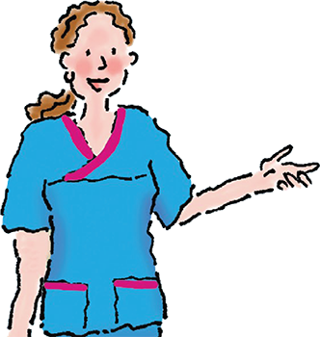
Survival Kit Resources
Apps, Apps, Apps (Instagram, Facebook, Medicaltalks, Medicalpedia, Dr. ZDoggMD, Nicole Kupchik)
Allnurses.com
Your classmates (misery loves company)
AACN pocket cards
CINAHL/ Pubmed/ Embase
Saunders NCLEX RN Exam App and Book
Nursing Made Incredibly Easy books – especially the EKG book
The website and journal are also good; this series is engaging & easy to understand

Slide 5
Books to add to the Nursing Experience
Final Gifts: Understanding the Special Awareness, Needs, and Communications of the Dying by Callanan and Kelley
The Last Lecture by Randy Pausch; When Breath Becomes Air by Dr. Paul Kalanithi
I Wasn’t Strong Like This when I Started Out: True stories of Becoming a Nurse by Lee Gutkind – highly recommended
Being Mortal by Atul Gawande
Every Patient Tells a Story: Medical mysteries and the Art of Diagnosis by Lisa Sanders
Nurse: The True Story of Mary Benjamin, RN by Peggy Anderson
Florence Nightingale - To Her Nurses (New Edition) by Florence Nightingale
Notes:
Final Gifts: Understanding the Special Awareness, Needs, and Communications of the Dying by Callanan and Kelley
This book by two hospice doesn’t read like a textbook at all but is actually used in nursing programs to teach nursing students about the special experiences and near death communications experienced by the dying and how to approach the care of the dying in a practical and genuine way; those of you interested in critical, acute, or hospice care are advised to read this book at some point
The Last Lecture
Randy Pausch was a computer science professor at Carnegie Mellon when he was diagnosed with terminal pancreatic cancer. In the tradition of the last lecture, Pausch delivered his on September 18, 2007 and called it, “The Last Lecture: Really Achieving Your Childhood Dreams.” It was filmed, uploaded to YouTube, and became a viral sensation You will face challenges as a nurse, some that will feel bigger than you can handle, but as Pausch states, “We cannot change the cards we are dealt, just how we play the hand.”
When Breath Becomes Air by Dr. Paul Kalanithi is a similar book by a neurosurgeon with a terminal brain tumor – beautifully written self-exploration of how a clinician faces his own death
I wasn’t strong like this when I started out: True stories of becoming a nurse
true stories come from a range of people, from nurses-in-training to those who’ve been in the field for decades. They cover life and death, but it’s the stories about everything in between that will move you; this book is the closest thing to what a real nurse experiences
Being Mortal by Atul Gawande
Best seller by Dr. Gawande, he examines end of life care, decisions, and the challenges in navigating these decisions in today’s healthcare environment; there is a Frontline documentary based on this book. This book will give you insight into why “moral distress” and “futile care” is a big issue for today’s clinicians.
Every patient tells a story: Medical mysteries and the art of diagnosis
Dr. Sanders reminds us that the right diagnosis doesn’t always involve a computer; sometimes, the most powerful tools are listening to the details and conducting a thorough physical examination. The essays are just as thrilling as “House,” but instead of Hollywood plotlines and special effects, their potency comes from their study of the science behind the cases and the examination of what went wrong
Nurse: The True Story of Mary Benjamin, RN by Peggy Anderson
Written in the 80s under a pseudonym because of some of the sad truths of nursing & medicine back then; a first-person account of what is is to be a nurse. A lot has changed in healthcare but this book is still an excellent story of eight weeks in the life of a nurse in a large urban hospital. It is all here: the joy and pain, the death and drama, the mistakes, successes, and secrets. Nurse reads like a novel, but sticks in the memory like real experience-because it is. Great read for a nursing student to enter into the mind and reality of a hospital nurse.
Florence Nightingale - To Her Nurses by Florence Nightingale
Compendium of letters written by Florence Nightingale to her nurses; much more relevant and interesting than her more famous “Notes on Nursing”; in her letters she addresses all kinds of things we still face today including treating patients of all backgrounds and classes with respect, dealing with patient deaths including peds, good versus bad charge nurses, nurse bullying and gossiping, night shift nursing, the need to have grit and matter-of-factness as a nurse, being moral examples to our patients but never proselytizing or preaching to them. Florence was a religious person who believed she was called by God to serve as a nurse and her exploration of her faith is genuine; those of you who are religious may appreciate her discourse on this topic but everyone at some point in their career will find something to relate to in this book.

Slide 6
Documentaries to add to the Nursing Experience
Year of the Nurse and Midwife Film (Tickets $6, & you can watch it virtually)
Frontline: Facing Death – highly recommended
Frontline: Being Mortal
Extremis
Escape Fire: The Fight to Rescue American Healthcare
The Immortal Life of Henrietta Lacks
Living in Emergency
Mission Critical – Inside the ICU (BBC via YouTube)
The American Nurse
Heroin(e)
Sicko
Notes:
Frontline: Facing Death
Exceptional documentary look at critical illness and the end of life. Every nursing student should watch this – and its likely that one of your classes will have you watch this; available for free via PBS website.
Frontline: Being Mortal
Dr. Atul Gawande’s exploration of the end of life decisions and care in today’s healthcare environment; similar to his book; available for free via PBS website.
Extremis
Documentary on life threatening illness in the ICU, only about 30 minutes long, available on Netflix; pretty good but not as good as the Frontline documentaries
Escape Fire: The Fight to Rescue the American Healthcare System
This documentary will prove interesting to healthcare professionals who see issues with the system every day
The Immortal Life of Henrietta Lacks
Cancerous cells from Henrietta Lacks lead to breakthroughs that change the face of medicine
Living in Emergency
This documentary film follows four doctors – all working with Doctors Without Borders – as they struggle to provide healthcare in the war-torn regions of Liberia and DR Congo.
Mission Critical – Inside the ICU
BBC documentary series available on YouTube; critical care in the British ICU looks different (paper charting, open wards, less nursing autonomy) but the fundamentals are the same and this is a very interesting and engaging series. In episode one, observe how they are always short staffed for nurses and short of beds, just like us.
The American Nurse
This documentary examines the healthcare system by following five nurses who work in different areas of healthcare, including working with veterans, cancer patients, in hospice at a prison and in labor and delivery.
Heroin(e)
his documentary focuses on the medical professionals who are working hard to combat the epidemic and trying to save the lives of those who have fallen into the depths of addiction. Nominated for an Academy Award, this documentary is set in West Virginia
Sicko
Michael Moore medical documentary also is controversial, as it uses personal stories to portray a healthcare system in the United States that is not fair for those who do not have the money for the best insurance.

Slide 7
How to Best Position Yourself to Land a Great New Graduate Nurse Job

Slide 8
Senior Preceptorship
If you are able to choose a clinical placement, choose a location that you have dreamt about working at place, and a unit that you particularly enjoy.
What if you do not have a unit of interest?
Try to get to know your preceptor really well, they might be the one writing you a letter of recommendation.
If you have a capstone project, pick something that will definitely help the unit.
If you do not have a capstone project, volunteer your time to help the unit with a nursing project they are working on.
Notes:
In your graduating year, you will have a senior preceptorship.

Slide 9
Things Students Shouldn’t Do
Do not act like you know everything, regardless of your prior experience
Do not be disrespectful
Do not say ”no”
Do not have a bad attitude
Do not act as if a clinical task is boring or beneath you
Do not use vulgar language
Do not check your cell phone at clinical or in class unless utilizing a nursing app
Notes:
You never know who knows who and who you’ll need for a reference letter – leave a good impression and be the professional nurse you aspire to be

Slide 10
Summer Externships
Different hospitals around the nation have extern programs while you are in nursing school where you can live near the hospital and work alongside a preceptor. You also attend classes and hospitals ”sell” you a graduate nurse position after nursing school by providing you tours and fun experiences with your fellow externs.
These programs are competitive, but they get your foot in the door to make an impression.
The programs will pay you during the summer.
You will be able to have an amazing experience as a nursing school student. You might make life-long friends with your fellow externs.
One example: Mayo Clinic Summer III, which takes place in the last summer before your capstone

Slide 11
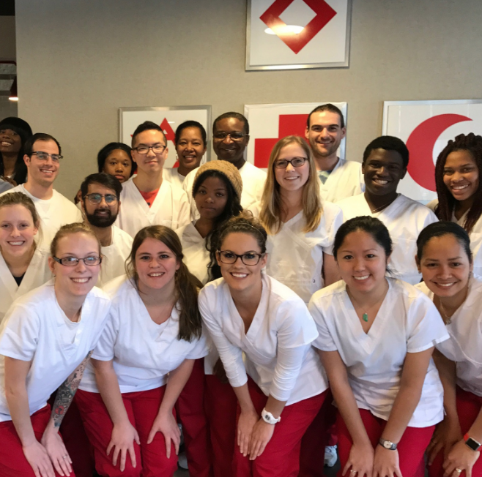
Get Involved!
Think ahead of what will set you apart for the future
Join SNA and then participate! Be a class rep, develop community events (charity run/ball/auction; blood donation etc)
Join another medical based group at school
Volunteer at a hospital – this can lead to a job as a CNA or RN
Volunteer as a medical interpreter or animal therapy leader
Become a CNA, medical assistant, or phlebotomist
Do things in the community that are healthcare-related
Become a mentor for students a year below you
Volunteer with the American Red Cross – they have scholarships and they’ll sponsor you to attend NSNA conferences
Notes:
Every opportunity to get involved is a chance to make a great impression, make a good connection, and maybe lead you to a great position as a graduate nurse; the more you get experience, the more comfortable you’ll be as a student nurse. For example: if you can make a bed with ease, you can focus on the critical thinking required of an RN.

Slide 12
Looking for work?
Create an Excel spreadsheet with all of the new graduate jobs when the application is open and last day to submit a lot with what is required
Create a portfolio that represents yourself
Practice, Practice, Practice interviewing
Apply to a bunch of places prior to obtaining your NCLEX and after
Apply out of state if necessary

Slide 13
Nursing Symposiums
You can attend as a nursing student!
Depending on what your interests are, there is a conference for you.
Emergency Nursing Association (ENA)
American Association of Critical Care Nurses (AACN)
Academy of Medical Surgical Nurses (AMSN)
Society of Critical Care medicine (SCCM)
Association of perioperative Registered Nurses (AORN)
National Association of Neonatal Nurses (NANN)
Society of Pediatric Nurses (SPN)
Sigma Theta Tau
You can also get involved with the local nursing chapters!

Slide 14
AACN San Fernando Valley Chapter

Slide 15
Thank You
Contact info
Lindsey Bloom, BSN, RN, CCRN, SCRN
Email: LBloomRN@gmail.com

